Slide 1
WELCOME TO OUR PRESENTATION
Group 1

Slide 2
OUR MEMBER
Phạm Lâm Phú
Nguyễn Đại Minh
Nguyễn Thiện Sang
Nguyễn Đức Thắng

Slide 3
TABLE OF CONTENTS
001
002
003
PROBLEM DESCRIPTION
MODELLING
METHOD
Describe here this section

Slide 4




THE PROBLEM
There are N points 1, 2, 3, ….., N having packages needing picking up and K postmen starting from the post offices (point 0).
Consider $d_{ij}$ of distance matrix d as the distance from point i to point j, with i, j = 0, 1, 2, 3, …., N.
We need to develop the picking-up plan for K postmen, and determine which points are visited by which postmen and in what order.
Route 1
Route 3
Route 2

Slide 5


THE PROBLEM
The plan must satisfy below conditions:
· The longest distance of a postman needs to be minimalized.
· The total distance traveled by K postmen is minimal.
Input:
· Line 1: N and K
· Line i+2 from 0->N-1: row i^{th} of distance matrix d
Route 1
Route 3
Route 2

Slide 6
Model

Slide 7


Notes:
C = {1,2,3,…N} : Number of cities
k = {1,2,3,..,K} : Postman number k
$d_{ij}$ : Distance from city i to city j
{
1 if postman k travel from city i to city j
0 otherwise
$x_{ijk}$ :

Slide 8
Objective function:
1. The longest path
2.The total distance

Slide 9
Constraint
1
2
3
4
Each city visited exactly once
City h must be visited and came out by exactly one postman
4
Each postman must start from start point (point 0)
Each postman must end at the depot (point 0)
5
Subtour – elimination constraint

Slide 10
Method 1

Slide 11
Integer linear programming
Using ‘SCIP’ solving real integer variable

Slide 12
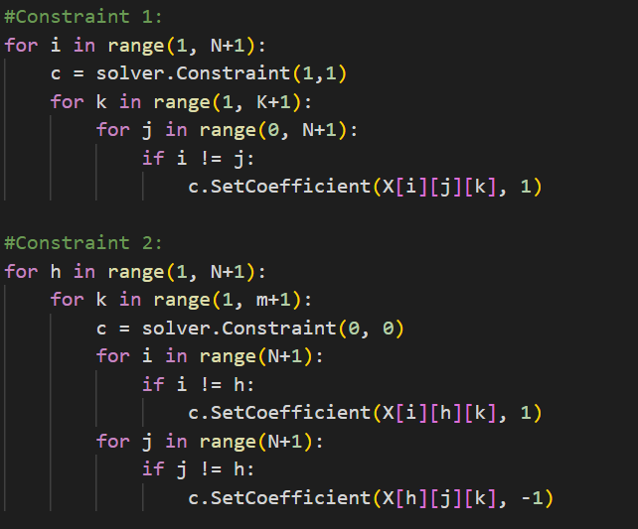
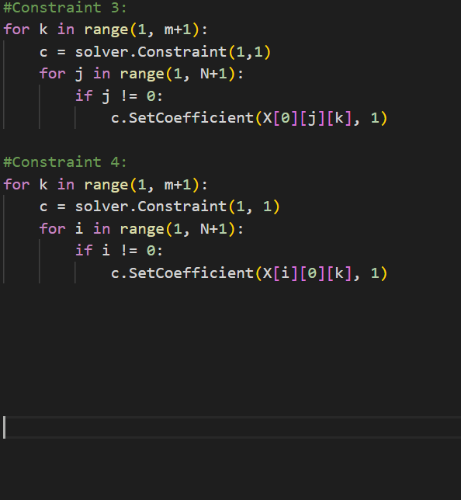
First four constraint

Slide 13
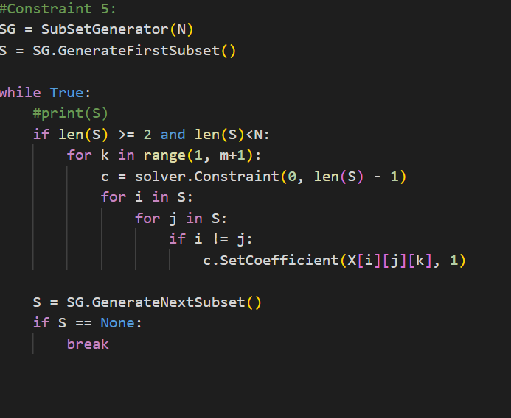
The fifth constraint
-Using sub-tour elimination method
-Number of visited nodes in graph will no more than number of nodes remains in S

Slide 14
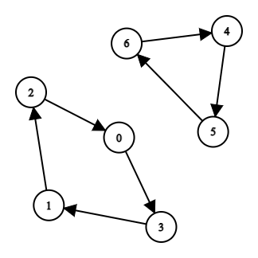
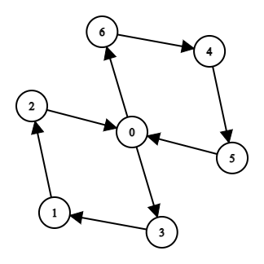
The fifth constraint
Step 1
Step 2
Step 3
Subtour-elimination constraint

Slide 15
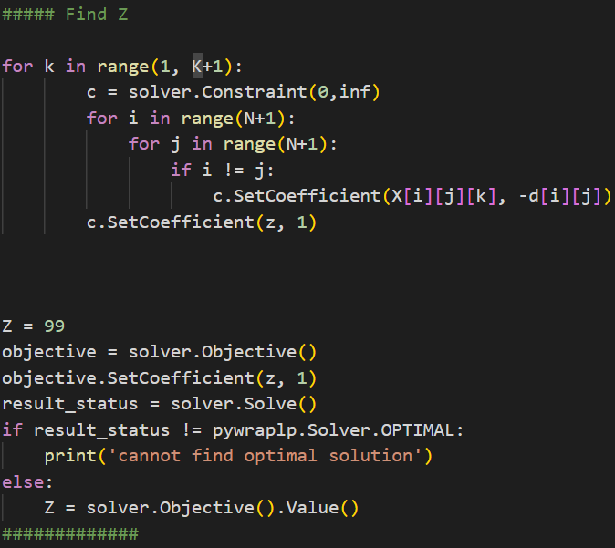
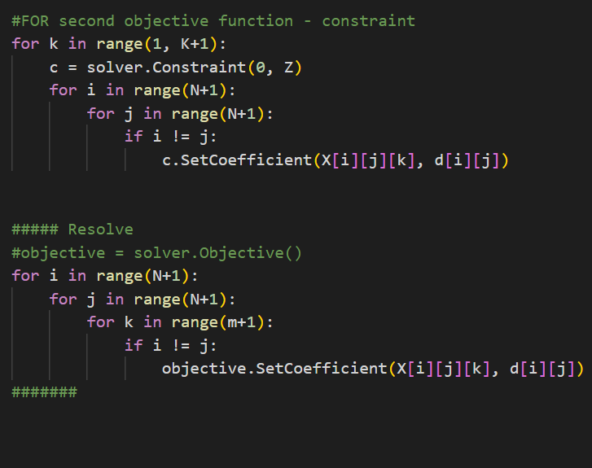
Solving second objective function
Solving first objective function,optimize solution

Slide 16




Constraint programming
Generate solution
Extract Subtour
Resolve with SECS until no Subtour found
1
2
3
0
8
6
5
4
Subtour
7
Add subtour (3-4-5) to SECS

Slide 17
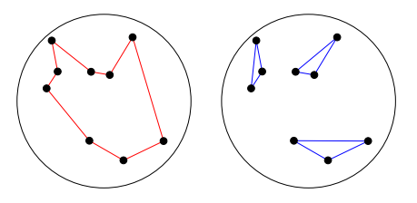
Constraint programming
*Dynamic-subtour:
Let S be the set of a nodes visited by subtour :
+if S={1,2,3,...N} than we found a global tour
+else the constraint saying that we must leave S at that once it violates

Slide 18
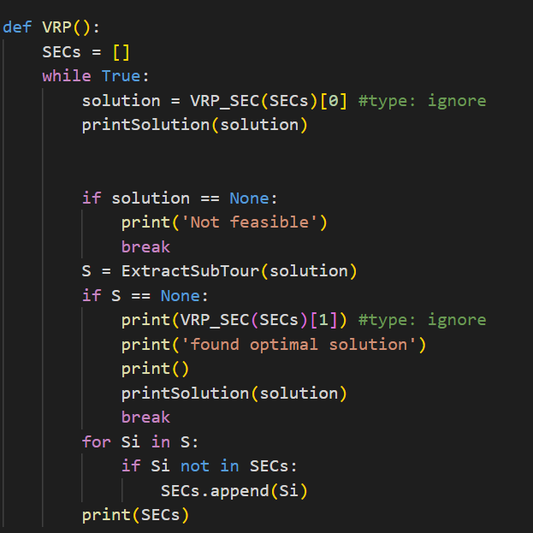
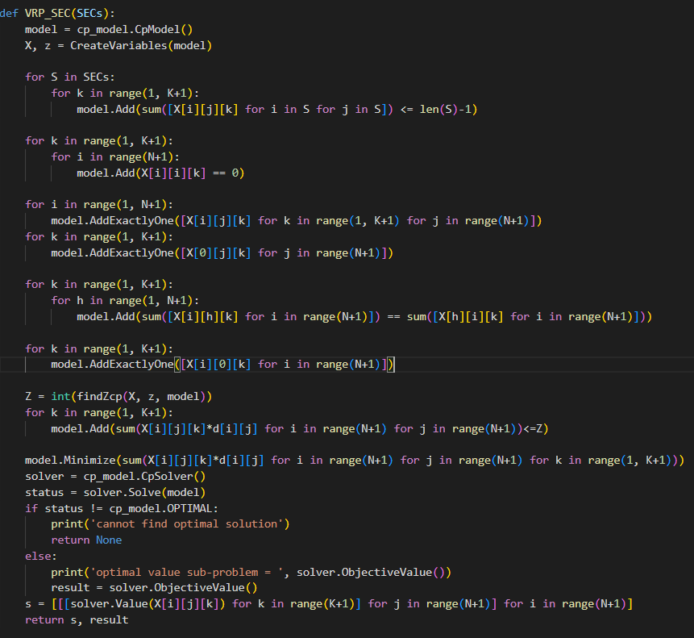
VRP
VRP_SEC

Slide 19
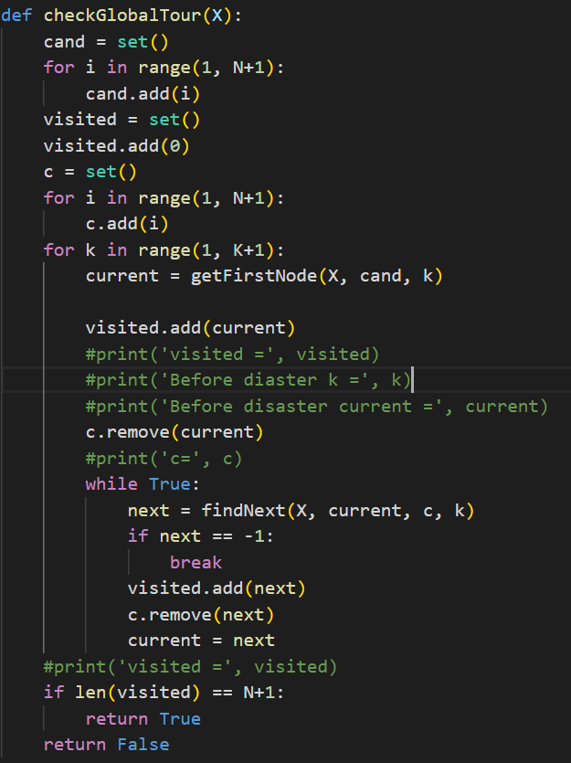
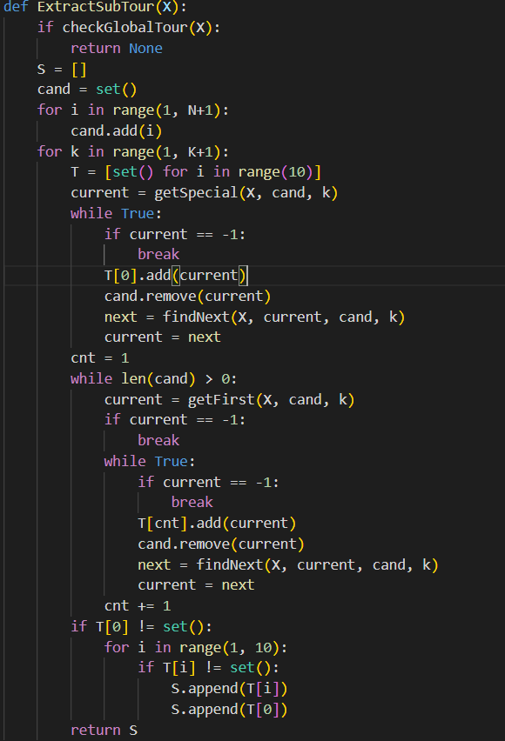
checkGlobalTour
extractSubTour

Slide 20
Advantage & Disadvantage
Advantage
Disadvantage
-Easily to describe with local constraint and sub-tour elimination constraint
-Too slow
-Cannot optimize with high N
-Impractical for real number

Slide 21
Method 3

Slide 22
Heuristic
1. Local search
The general idea is therefore to start from a solution obtained by randomizing and improve it locally. The process is repeated until no further improvement is achieved.
The general idea is to use 4 operators to try to improve the solution quality by considering 4 potential moves. Choose the move that gains the best improvement (decreases the objective function most) and perform it. Each operator will provide a potential move according to First Improvement policy
Algorithm : General framework of local improvement method.
Input: Solution s, method modifying a solution
Result: Improved solution s
1 repeat
2 if there is a modification of s into s’ improving s then
3 s ← s’
4 until no improvement of s is found

Slide 23
Heuristic
I. Local search
General Framework of Algorithm :
Input: solution s, function gain(…) to compute the gain of each operator and choose the best one.
Output: improved solution s
1 repeat
2 if gain(operator1, operator2, operator3, operator4)<0 then
3 perform move that gains the best improvement (decreases the objective function most)
4 until gain(operator1, operator2, operator3, operator4) >= 0

Slide 24
I. Local search
1 Operators
Intra-route: a change within one route
Inter-route: involving at least two routes
i
j
O
1.1 2-opt Intra-Route move
-Performs an exchange of 2 edges.
-Choose nodes i and j from the same route, with i + 1 < j.
-Delete arcs i -> i + 1 and j -> j + 1. Replace with i -> j and i + 1 -> j + 1. This reverses the order of nodes from i + 1 to j.
i+1
j+1
i
j
O
i+1
j+1
2-opt intra-route

Slide 25
I. Local search
1.2 Swap
It swaps city i and city j belonging to different routes (k1 and k2).
i
j
i
j
O
O

Slide 26
I. Local search
1.3 Relocate
It takes city i from route k1 and optimally insert it after city j into tour k2
i
i
j
j
O
O

Slide 27
I. Local search
1.4 2-opt inter-route move (tails swap)
It takes city i from route k1 and optimally insert it after city j into tour k2
. . .
i
j+1
O
O
. . .
j
i+1
. . .
i
j+1
O
O
. . .
j
i+1

Slide 28
II. Greedy Heuristic Based on Local Search for TSP
-”insert” sequentially the city in solution for TSP to the deliveryman
-If the length of the current route is larger than the average length, :
+stop inserting the next city to this route
+add the next city in the TSP solution to the next route
-Appropriate for Large Scale VRP (N > 200)

Slide 29
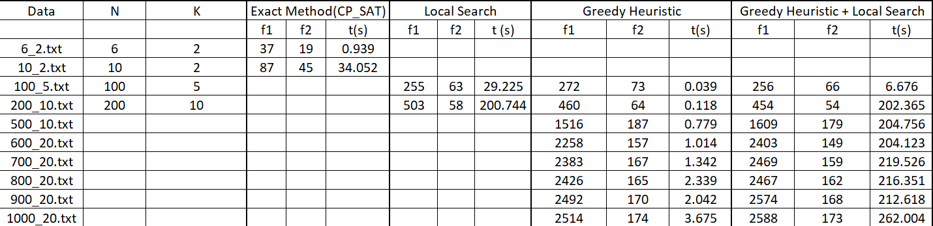
Result table

Slide 30
References
1. É. D. Taillard, Design of Heuristic Algorithms for Hard Optimization, Graduate Texts in Operations Research, https://doi.org/10.1007/978-3-031-13714-3_6
2. Osterman, C., Rego, C.: A k-level data structure for large-scale traveling salesman problems. Ann. Oper. Res. 244(2), 1–19 (2016). https://doi.org/10.1007/s10479-016-2159-7
3. Michael Huemer, 2011, Heuristics for the vehicle routing problem with multiple deliverymen, München, GRIN Verlag, https://www.grin.com/document/232841
4. Editors: F. Rossi, P. Van Beek, T. Walsh, 2006, Handbook of Constraint Programming (Foundations of Artificial Intelligence), https://www.sciencedirect.com/bookseries/foundations-of-artificial-intelligence/vol/2/

Slide 31
THANKS!
For Your Listen

